Slide 1
API
Application Programming interface

Slide 2
What api does
Responsible of interactivity between user side and server side
Example as waiter in a restraint

Slide 3



API

Slide 4
Types of api
Open APIs: Also known as Public API, there are no restrictions to access these types of APIs because they are publicly available.
Partner APIs: A developer needs specific rights or licenses in order to access this type of API because they are not available to the public.

Slide 5
Types of apis
Internal APIs: Also known as Private APIs, only internal systems expose this type of API. These are usually designed for internal use within a company. The company uses this type of API among the different internal teams to be able to improve its products and services.
Composite APIs: This type of API combines different data and service APIs. It is a sequence of tasks that run synchronously as a result of the execution, and not at the request of a task. Its main uses are to speed up the process of execution and improve the performance of the listeners in the web interfaces.

Slide 6
Different types of api architechture
SOAP
XML-RPC
JSON-RPC
REST

Slide 7
SOAP (Simple Object Access Protocol):
This is a protocol that uses XML as a format to transfer data. Its main function is to define the structure of the messages and methods of communication. It also uses WSDL, or Web Services Definition Language, in a machine-readable document to publish a definition of its interface.

Slide 8

XML-RPC:
This is a protocol that uses a specific XML format to transfer data compared to SOAP that uses a proprietary XML format. It is also older than SOAP. XML-RPC uses minimum bandwidth and is much simpler than SOAP. Example

Slide 9
JSON-RPC
This protocol is similar to XML-RPC but instead of using XML format to transfer data it uses JSON. Example

Slide 10
REST (Representational State Transfer)
A style of software architecture
A collection of network architecture principles which outline how resources are defined and addressed
Exchange of data using either XML or JSON

Slide 11
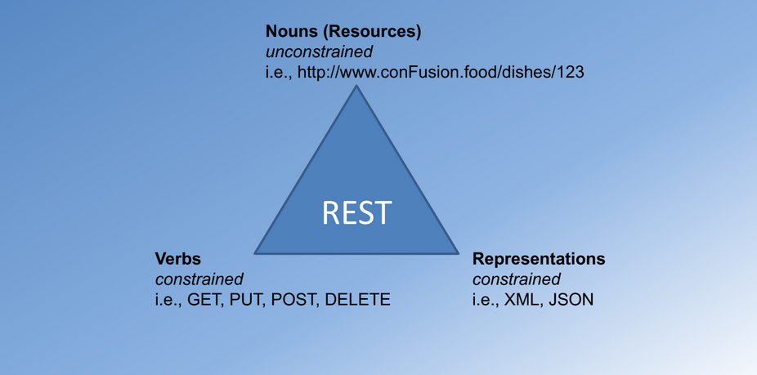
REST Concept

Slide 12
1. Resources
Represented with a global identifier (URI in HTTP)
http://github.com
REST uses URI to identify resources
http://github.com
http://www.github.food/Shubhamdutta2000/
http://www.github.com/samratc030/

Slide 13
2. Verbs
Represent the actions to be performed on resources
Corresponding to the CRUD operations
HTTP GET =>READ
HTTP POST => CREATE
HTTP PUT => UPDATE
HTTP DELETE => DELETE

Slide 14
3. Representation
How data is represented or returned to the client for presentation
Two main formats:
JavaScript Object Notation (JSON)
XML

Slide 15
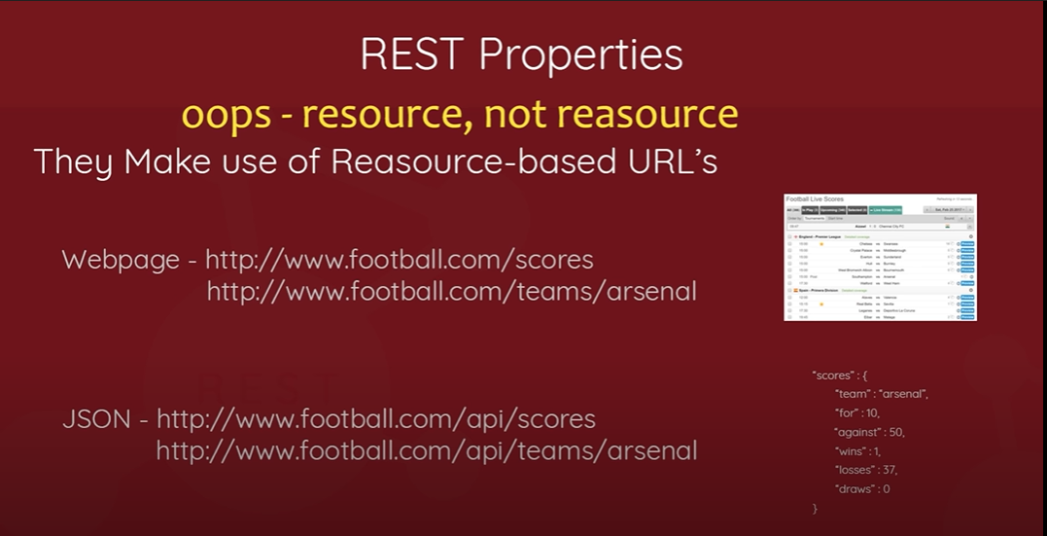
REST (Representational State Transfer)

